Slide 1
MAKHADO MUNICIPALITY
TOURISM DEVELOPMENT
AND
MARKETING PLAN

Slide 2
PHASE 1
Identify tourism expectations in the IDP
Consultative Process - Workshops for Ward Councillors and Operators
Obtain a full understanding of the products and attractions - interviews with key role-players and stakeholders
Understanding the markets - present & potential, and trends in demand
Preliminary compilation of a database

Slide 3
PHASE 2
Identification of development opportunities
Responsible Tourism Guidelines
Investment incentives and support systems
Threats and constraints to tourism development
Creating benefits for local communities and entrepreneurs
Institutional structures
Upgrading of the database

Slide 4
PHASE 3
A Marketing Plan
Setting Objectives
Performance Monitoring
Implementation schedule
General
Final database of facilities

Slide 5
EXTRACTS FROM THE IDP
Illegal immigrants pose a major problem
Population growth rate is much higher than the economic growth rate
Local tourism not developed to full potential
No proper marketing plan for tourism
Conservation & environmental matters not well understood or practiced
Poor infrastructure to attract investors
Weak linkages between tourism & trade

Slide 6
IDP - MORE….
9 Wards identified tourism needs
Key opportunities: Ribolla Tourism Project, Welcome Boards at Lwamondo, Tshakuma Dam and Mangwele Caves, Kokwane Footprints & Tshiendeulu Ruins, Vhuhea Cave, Dzata Museum and historical site, Tourism Information Centre
Two thirds of Wards wanted additional or new ‘recreational facilities’

Slide 7
CONSULTATIVE WORKSHOPS
Ward Councillors - 22 attendees
Presentation on how the tourism industry works and the expectations of the Tourism Development Plan
Presentation on the Limpopo Tourism Growth Strategy
Explanation of the Resource Questionnaire seeking information on all man-made, natural, historical and cultural products and resources. This questionnaire was also sent out to Councillors who did not attend the Workshop

Slide 8
WORKSHOPS - CONTINUED
Operators - 33 attendees
Explanation of the expectations of the Makhado Tourism Development & Marketing Plan
The relevant elements of the Limpopo Province’s Tourism Growth Strategy
Positive and negative factors affecting tourism
Expectations regarding the role of the Municipality and other tourism role-players
Appropriate structures & budgets

Slide 9
POSITIVE FACTORS
Cultural heritage and arts & crafts
History
Diversity & contrasts - scenery/nature/activities
Position - N1 ~ TFCAs ~ KNP etc.
The Soutpansberg - high biological diversity
Hunting
Farming activities & produce
The Tourism Centre
Events - but need more
Nice Friendly People!

Slide 10
NEGATIVE FACTORS
Little or no funding & support for new projects
Insufficient communication
Bad infrastructure - roads and signage!
Not enough marketing
Fragmented industry and jealousy
High toll road fees
Is tourism really taken seriously by Government?
Zimbabwe and other unsettled situations
Lack of awareness and capacity
Services not up to standard

Slide 11
EXPECTATIONS FROM AUTHORITIES
MUNICIPALITY
Funding for marketing, keep it crime-free, make the TIC work, support CTAs
PROVINCIAL
Assist CTAs within Municipalities - capacity building, road signage, Website, roads, communication
LOCAL CTA
Interact & communicate

Slide 12
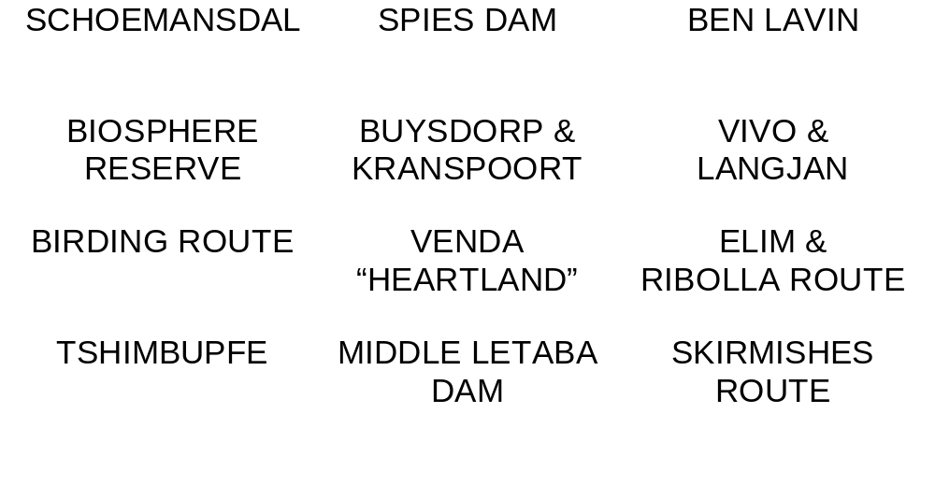
INTERVIEWS & FIELD TRIPS

Slide 13
MARKET ANALYSIS
NATIONAL
Arrivals and trends
DOMESTIC
SATourism/DEAT research
PROVINCIAL
Arrivals and trends
LOCAL
Visitor profiles, occupancies, trends, seasons, activities, repeat/1st time,length of stay, operator expectations & SWOT analysis

Slide 14
DEVELOPMENT ‘HOT SPOTS’
Western Soutpansberg - Buysdorp, Kranspoort, Lajuma & Salt Pan
Elim & Ribolla Route
Skirmishes Route
Birding Route
Venda ‘Heartland’
Events
TIC & surrounds
Interpretation & signage

Slide 15
OTHER FINDINGS
The Responsible Tourism Guidelines - economic, social & environmental + Fair Trade in Tourism
Investment Incentives
Threats and constraints - Bad communication, Zimbabwe, marketing lacks focus, fragmentation, opportunities not exposed, toll road fees, products not ‘packaged’, inadequate support for new enterprises, need to do things differently, lack of funding, capacity constraints, environmental degradation, no appropriate research

Slide 16
OTHER FINDINGS - CONTINUED
Creating Local Benefits from Tourism - the ‘pre-conditions’ for successful operations, use of community assets, private entrepreneurs, access to resources within protected areas, utilization of cultural heritage, need for a support unit
Institutional Structures - CTA functions and responsibilities, Local & District Municipalities
Linkages - TFCAs ~ KNP ~ Blouberg ~ Giyani ~ Musina ~ Limpopo Valley
Database

Slide 17
SETTING OBJECTIVES
Use local research findings to establish benchmark performance - present value of tourism is R 117m
Base objectives on Provincial Tourism Growth Strategy - double tourism’s contribution to local economy in 5 years
What we need is another 90 visitors per day by 2008!
Achieving this objective will require massive investments in marketing and new product development - not all by Makhado Municipality as help will be sought from Province etc.
Provincial implementation plan?

Slide 18
MARKETING PLAN
Focus on local, domestic and then international markets
Domestic = ‘independent young couples and families’ and ‘golden active couples’
Take note of the trends - design product and marketing strategies around market needs
Communication steps - ‘awareness’ ~ ‘knowledge’ ~ ‘commitment’ ~ ‘action’
Budget - initial R 600 000

Slide 19
PERFORMANCE MONITORING
MUNICIPALITY
Database registration and monthly returns from operators
HOST Index to measure ongoing sustainability and to monitor impacts and ‘issues of concern’
Increased research to understand markets and trends
OPERATORS
Code of Responsible Tourism - social, economic and environmental factors + BEE Scorecard

Slide 20
IMPLEMENTATION SCHEDULE
Priority No 1
Local institutional structures
Fine-tune the Growth Strategy
Additional research
Establish a Tourism Marketing Forum
Interpretation of key sites
The Venda “Heartland”
Western Soutpansberg Tourism Node
Support existing route initiatives
Events

Slide 21
IMPLEMENTATION - MORE….
Priority No 2
Spies Dam
New Routes - history
Schoemansdal
Donkey Tourism
Guide training
Reaction to proposals
Awareness amongst local communities
Investors’ Guide
Support Biosphere Initiative

Slide 22
BUDGET IMPLICATIONS
Development projects
A ‘basket’ of products has been costed but help will be needed from other funding sources
Marketing
Need R 600 000 in Year 1
Suggest increased contribution from private sector
GROWTH OBJECTIVES WILL NOT BE ACHIEVED WITHOUT SUBSTANTIAL NEW INVESTMENTS

Slide 23
ACKNOWLEDGEMENTS
STRISA acknowledges the support given by the Makhado Municipality, tourism and conservation organizations and operators
STRISA expresses its willingness to be involved with any follow-up or implementation work
STRISA TEAM - Michael Gardner, Robin Gardner, Isaac Rambauli, Jan Joubert, Glen Steyn, Vincent Carruthers, James Ndhlovu, Josephine Letsoalo

